Slide 1
Time Series Correlation of FOB, Basis, and Futures
Dylan Kallman
Term Project: 644

Slide 2
Introduction
Description: This presentation will go over the basics of the new globex Brazil soybean contract and how arbitrage would work.
Thesis: By better understanding this new contract, hedgers can create a competitive edge by trading futures to limit existing risk. How this new contract works, and understanding what variables are moving the contract will give traders, exporters, producers a competitive advantage in handling business decision.

Slide 3
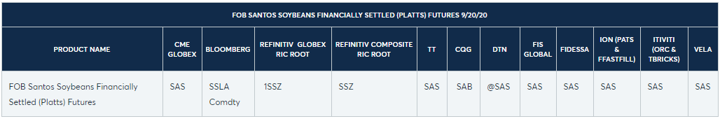
Globex Brazil Soybean (SAS)
It will be listed o the CME Globex 8:30 a.m. – 1:20 p.m. CT Monday through Friday (settlement time remains 1:15 p.m. CT. Ticker will be SAS. The listed contracts will be January, February, March, May, July, August, September, and November with 11 contracts listed at any time.
Added Benefits |
Will create more effective hedge for South American producers, exporters, and importers of Brazilian soybeans ‒ as it reflects export price at the Port of Santos. Currently needed to have a long position in Brazil to hedge local basis.
An opportunity to trade the spread between North American and South American soybeans, and effectively, the South American soybean basis

Slide 4
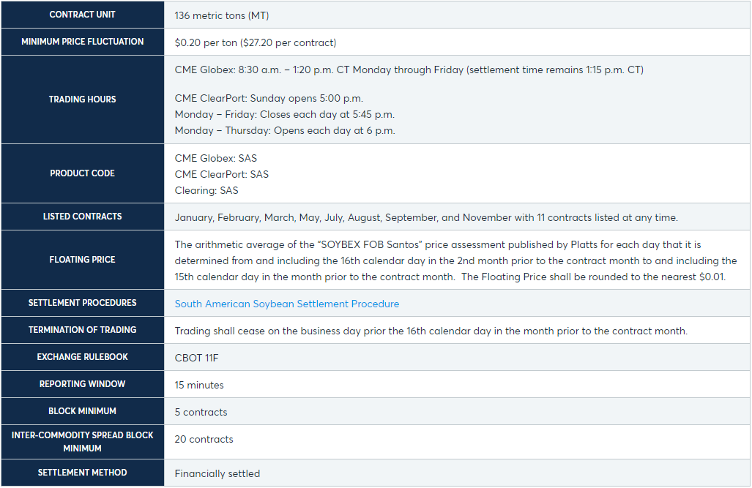
Contract Details

Slide 5
How does the Basis Hedge work?
In order to understand the mechanisms, you need to understand how the basis hedge will work. Basis is the price premium or discount of the relative cash and futures. It is driven by local supply and demand and transportation costs.
Through the new south American soybean contract hedgers can know hedge against basis risk by creating a synthetic basis contract. By trading the spread of the south American contracts (SAS) and American contract (ZS). Represented as SAS – ZS = Synthetic basis hedge. Example,
If traders Sell SAS and Buy ZS, they are short Brazilian Basis.
If a trader Buys SAS and Sells ZS, they are long Brazilian Basis.
Buy SAS = $374/Metric Ton (mt) = $10.18/bushel (374/36.74 = 10.18) “36.74 = bu per MT”
Sell ZS = $9.82/bushel
This gives a basis of 10.18 – 9.82 = .36, this mean you are long Brazilian basis.
If a Brazilian exporter is concerned about the basis weakening, he could Sell SAS and Buy ZS which would make him short the Brazilian basis.

Slide 6
How Arbitrage would work
An arbitrage will occur when it will be economically incentivizing to take delivery of a good and sell it in the premium traded market. Meaning if you can buy ZS at $9 and deliver it to Brazil at $9.50, (transportation cost of 50 cents), and then sell it at $10 SAS in the premium market that would be an arbitrage of 50 cents. This could be a Brazilian exporter who is selling beans to china and has an option to buy local beans at a $9.80 or 20 cent margin or he could take delivery of US grain in NOLA and ship it to Santos for 50 cents a bushel which would give him a margin of 50 cents.
Hypothetically if the US is trading at $9 and it cost less then a dollar to ship soybeans to China, they would hypothetically buy US beans. However, due to trade wars, political bias, quotas, and uncertainty this could happen.
Another factor to remember is that commodity markets are efficient. Meaning all market data should be represented in the commodity’s price. If these arbitrages do occur it is often due to macro political climate, but not exclusively.

Slide 7
Data Information
Data: was collected from Agricensus, DTN, TR, and Bloomberg.
Time Horizon: Data was collected from Q4 2017 to current.
Frequency: Daily
Data Assumptions:
Since I am looking at short term data (~3 years) I used a higher frequency. The reason I stopped at Q4 2017 was due to not being able to pull data from further back for FOB off Agricensus.

Slide 8
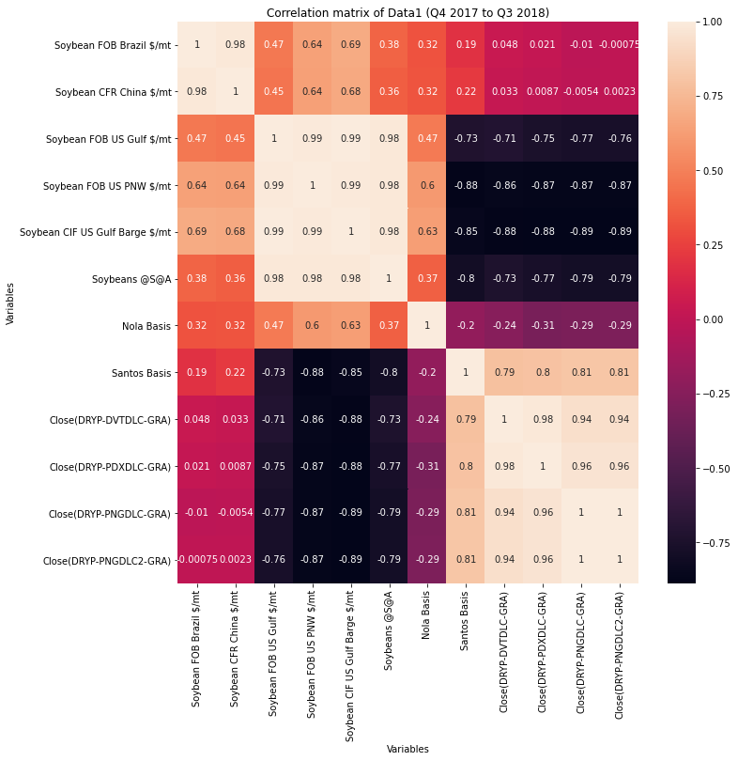
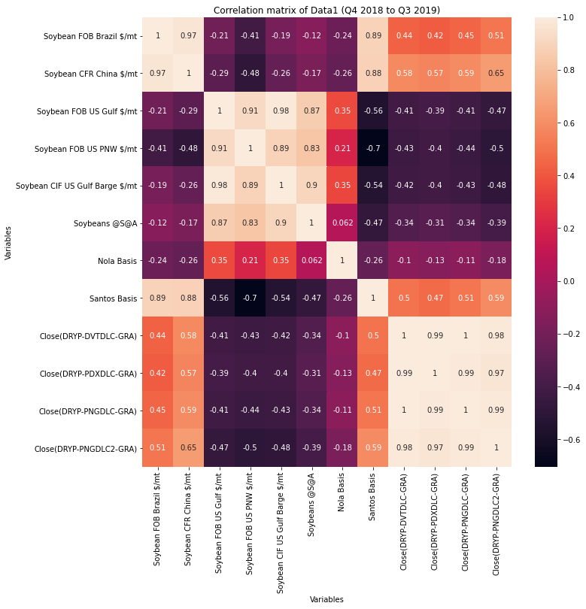

Slide 9
Trends

Slide 14
Changes

Slide 16
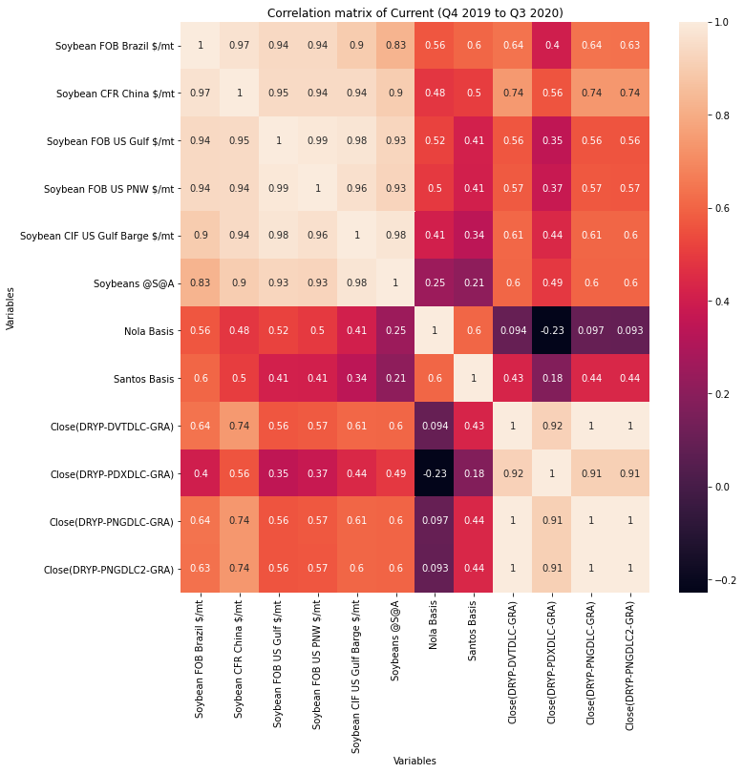
Current Data Catalyst
COVID
Export demand
Supply uncertainty (droughts, capacity)

Slide 17
Key
FOB – Free on Board (or Freight on Board). This is the cost of delivering the goods to the nearest port is included but you, as the buyer, are responsible for the shipping from there and all other fees associated with getting the goods to your destination.
CIF – Cost, Insurance and Freight. In this case, the price also includes sea freight charges and insurance to deliver the goods to your nearest port. But only to port – from that point onwards, you take the shipment into your hands.
CFR -- Cost and freight. This contract specifies the seller is required to arrange for the carriage of goods by sea to a port of destination and provide the buyer with the documents necessary to obtain them from the carrier.
Values from Thomson Reuters in USD/mT
Origin | USG | PNW | Brazil | Brazil
Destination | Dalian, China | Dalian, China | Dalian, China | Dalian, China
Vessel Type | Panamax | Panamax | Panamax | Panamax
Route (if applicable) |  |  | Panama Canal | Cape Hp
Cargo | Grain | Grain | Grain | Grain
Unit of Measure | USD / mT | USD / mT | USD / mT | USD / mT
Location | USG | PNW | Brazil | Brazil
Date | Close(DRYP-DVTDLC-GRA) | Close(DRYP-PDXDLC-GRA) | Close(DRYP-PNGDLC-GRA) | Close(DRYP-PNGDLC2-GRA)
Date | Close(DRYP-DVTDLC-GRA) | Close(DRYP-PDXDLC-GRA) | Close(DRYP-PNGDLC-GRA) | Close(DRYP-PNGDLC2-GRA)

Slide 18
Conclusion
By tracking these indicators, one can get a better understand what is moving the market. In this dataset we see,
Strong correlation
Soybean FOB Brazil $/mt & Soybean CFR China $/mt
Soybean FOB US PNW $/mt - Soybean CIF US Gulf Barge $/mt - Soybeans @SA & Soybean FOB US Gulf $/mt - Soybean FOB US PNW $/mt - Soybean CIF US Gulf Barge $/mt
Close(DRYP-PDXDLC-GRA) - Close(DRYP-PNGDLC-GRA) - Close(DRYP-PNGDLC2-GRA) & Close(DRYP-DVTDLC-GRA) - Close(DRYP-PDXDLC-GRA) - Close(DRYP-PNGDLC-GRA)
Moderate correlation
Soybean FOB US Gulf $/mt - Soybean FOB US PNW $/mt - Soybean CIF US Gulf Barge $/mt – Soybeans @SA - Nola Basis & Soybean FOB Brazil $/mt - Soybean CFR China $/mt
Inverse correlation
Santos Basis - Close(DRYP-DVTDLC-GRA) - Close(DRYP-PDXDLC-GRA) - Close(DRYP-PNGDLC-GRA) - Close(DRYP-PNGDLC2-GRA) & Soybean FOB US Gulf $/mt - Soybean FOB US PNW $/mt - Soybean CIF US Gulf Barge $/mt - Soybeans @S@A
If you are a hedger, export, importer, producer or something in between, this new contract will provide more market efficiency and help limit existing global market risk.

Slide 19
Related Readings
Francesca de Nicola, Pierangelo De Pace, Manuel A. Hernandez, Co-movement of major energy, agricultural, and food commodity price returns: A time-series assessment, Energy Economics, Volume 57, 2016, Pages 28-41, ISSN 0140-9883, https://doi.org/10.1016/j.eneco.2016.04.012. (http://www.sciencedirect.com/science/article/pii/S0140988316300913)
Annastiina Silvennoinen, Susan Thorp, Financialization, crisis and commodity correlation dynamics, Journal of International Financial Markets, Institutions and Money, Volume 24, 2013, Pages 42-65, ISSN 1042-4431, https://doi.org/10.1016/j.intfin.2012.11.007. (http://www.sciencedirect.com/science/article/pii/S1042443112001059)
Zhihui Li, Xinsheng Lu, Cross-correlations between agricultural commodity futures markets in the US and China, Physica A: Statistical Mechanics and its Applications, Volume 391, Issue 15, 2012, Pages 3930-3941, ISSN 0378-4371, https://doi.org/10.1016/j.physa.2012.02.029. (http://www.sciencedirect.com/science/article/pii/S0378437112001768)

